Slide 1

Assignment Solution -- Data Engineer -- Lishe Zhu

Slide 2
AGENDA
- Pre - Analysis & Assumptions
- Part 1 Extract and Load
- Part 2 Transformation
- Part 3 Data Quality & Analysis
- Challenge I faced & Further Idea
- Questions from Interviewers

Slide 3
Pre-Analysis & Assumptions

Slide 4
Pre-Analysis & Assumptions
The data I can get from API is only for some basic information Comic and no other documentation to explain the meta data and other information.
There are two type of API I can use to get the data. One is https://xkcd.com/info.0.json to get the current record of the data. And another is https://xkcd.com/{num}/info.0.json . For the second one, based on different num, I can get different record. (num 404 not available)
Assume the way how API update is that once there is something new, the content from https://xkcd.com/info.0.json will be updated. At the same time, it will only contain the latest record, the previous records will go into the second type of API endpoint.
For the data itself, num is unique identifier like id. Year, month, day is a combination for date and will be used quite often in daily query.
Outside of this assignment, in real project, will get more topics of related data, thus the solution is designed for multiple entities. And assume the API structure will be the same as Comics.
Assume customer can also reward the comic, which is where the revenue comes from.
*Since all of my experience is in Azure, I provide my solution in Azure.

Slide 5
Part 1 Extract & load

Slide 6
Extract & load -- Database Tables
1. Control table to store meta data for each entity
- Id,
- EntityName,
- Num_Max_DB (Indicate what is already loaded into db),
- LastAttemptDatetime (Indicate when is the latest attempt to get new data)
- BasicEndpointurl (Basic structure of API endpoint)
- FullLoad (Indicate will we do a fullload or a incremental load)
2. tmp.ComicsBasic to be the destination of loaded data
In order to avoid some basic data quality issue based on my assumption, some simple restriction is already applied. (NULL/NOT NULL/Unique)
Indexes created based on the assumption. (Unique Clustered Index based on num & non-clustered indexed based on year, month,day)
You can find detailed SQL script by Clicking here.

Slide 7
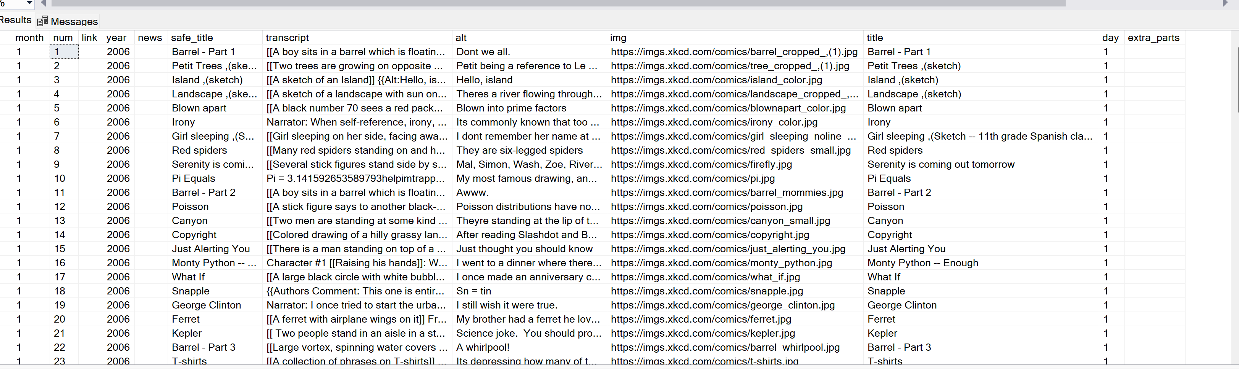
Extract & load -- Python Script to load data
Based on different loading mode needed, the script will load all of the records or a part of the overall records. (If it’s fullload from control table, then the code will go trough all of the APIs with different num; If it’s a delta load, based on the max num in control table, the code will only load the new part of the data.)
In order to improve the insert performance, I divided the whole dataframe into chunks; It can also help to debug, once the data insert activity failed.
The code is dynamic, including the entity and num. Which helps to increase the scalability of the solution.
* Since this is an assignment , I saved all of 3120 records data into csv locally and only inserted 100 records into the database.
Please find the CSV file by clicking here.
Please find the Python script by clicking here.

Slide 8
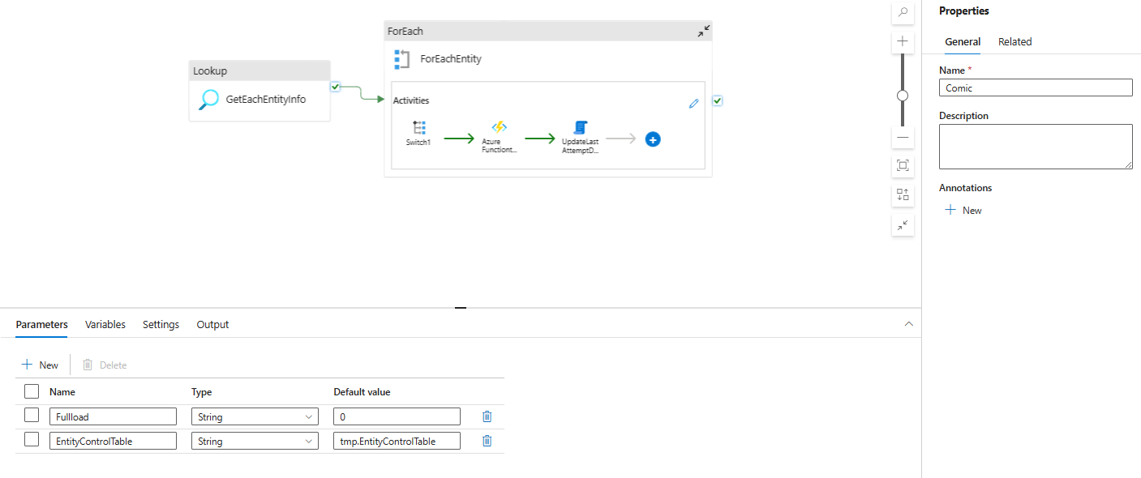
Extract & load -- Data orchestration & trigger
Used Azure Data Factory to do the orchestration to automate the process.
Started from the control table. Use a foreach activity to process each entity in the control table. First of all, to update the fulload value in the control table based on the parameter passed.
And then using Azure Function App activity to run the python script to load the data.
Then update the LastAttemptDatetime in control table for users information.
Please find the pipeline configuration by clicking here.

Slide 9
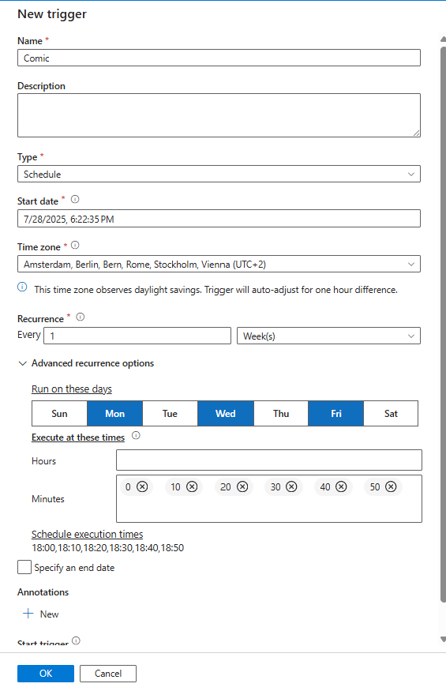
Extract & load -- Data orchestration & trigger
2. Trigger for the process.
Option 1: Based on my current solution, create a ADF schedule trigger. For every Monday, Wednesday and Friday, it will run every 10 mins to catch the new data as soon as possible.
Please find the trigger configuration by clicking here.
Option 2: Create a time trigger for Function Apps. And in the __init__.py, define the poll logic. For every 10 mins on Monday, Wednesday and Friday, check whether the current num is the larger as what we have in database. If yes, then run the Function app to load the data.
(If use this case, Script need to be enriched for updated the load mode based on need. )

Slide 10
Part 2 Transformation

Slide 11
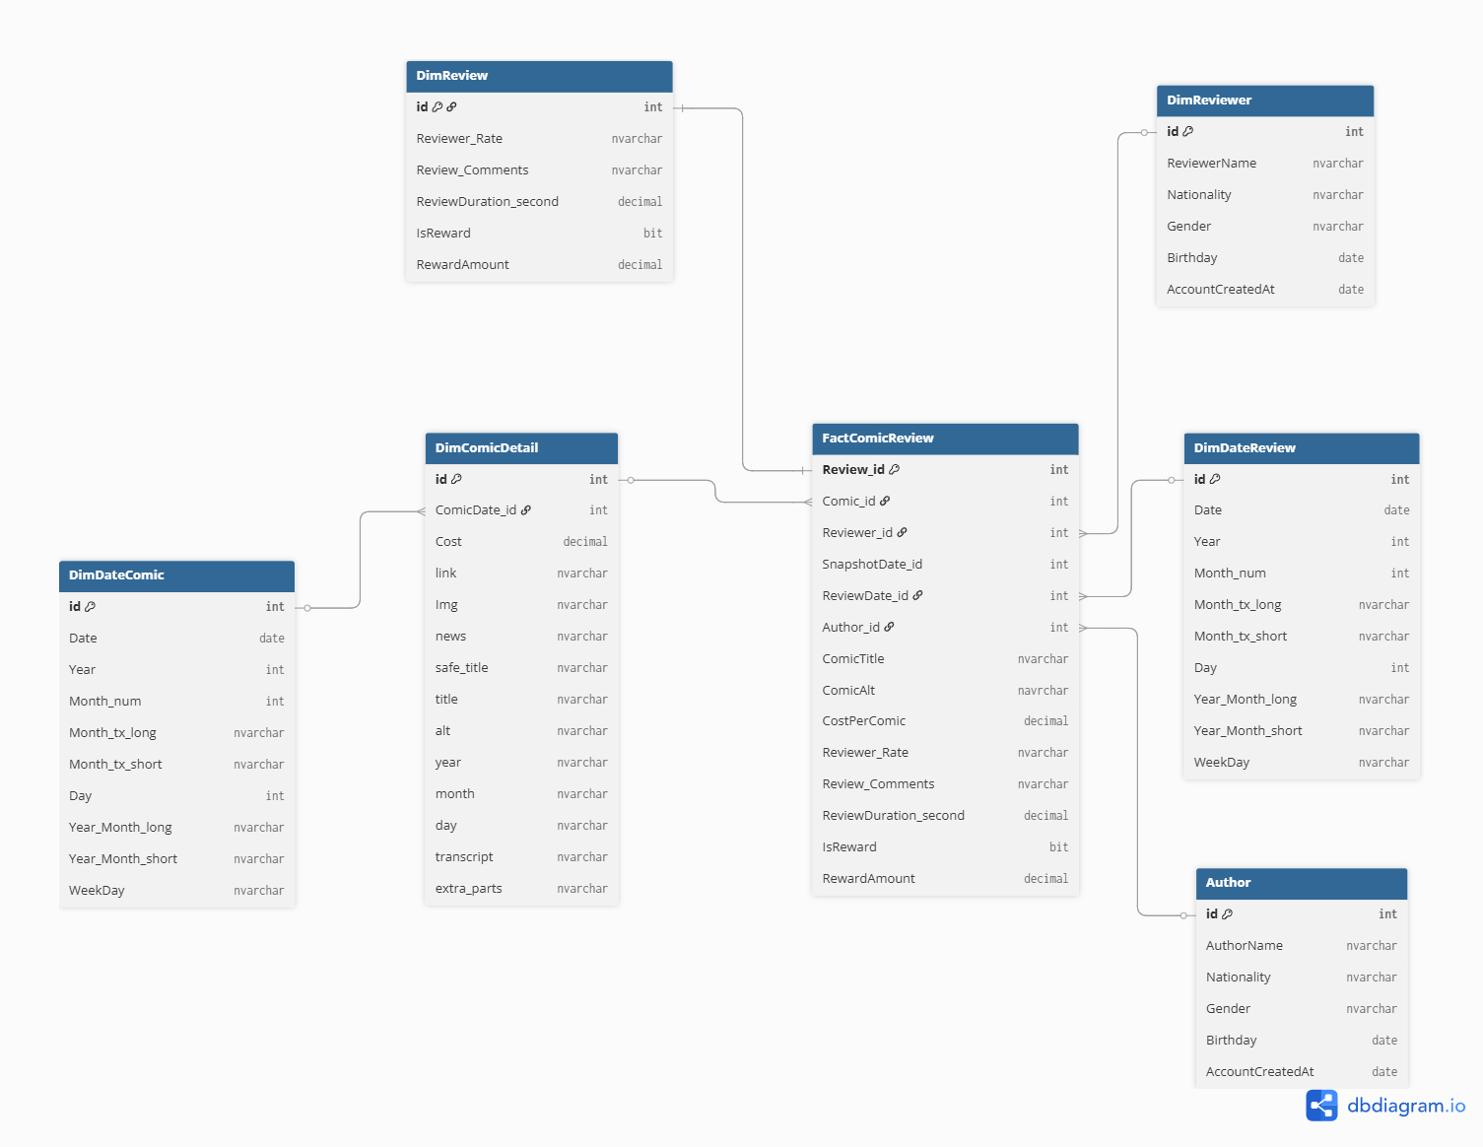
transformation -- Data model
Kimball Dimensional Modeling
FactComicReview: Fact table, including foreign_keys to join with other dimension table, and other measurable fields for reviews
DimComicDetail: Dim table, each row refers to one comic and the fields here are to describe Comic feature
DimReviewer: Dim table, describe reviewers’ feature
DimeAuthor: Dim table, describe authos’feature
DimDateComic: Dim date table, to describe Comic created date features
DimDateReview: Dim date table, to describe review happen date features

Slide 12
transformation -- Table & procedure in database
Current table for dimComics as well as the procedure to load data is created
- Can also use user-defined table type parameter and procedure to process the data. - Use SCD_Type 2 to save history records. (In real work based on need to decide whether to scd type 2)
- Test SCD Type 2
2. All of the other tables are created in database, included fact table and dim tables
3. Indexes are created based on the unique key and other assumptions
4. Procedures are created to load the fact table and dimension tables
Please find all of the table creation SQL query here.
Please find procedure to load dim ComicDetail here (SCD Type2).
Please find procedure to load fact table here.
Because of lack of the data, didn’t create for other dim table loaders.

Slide 13
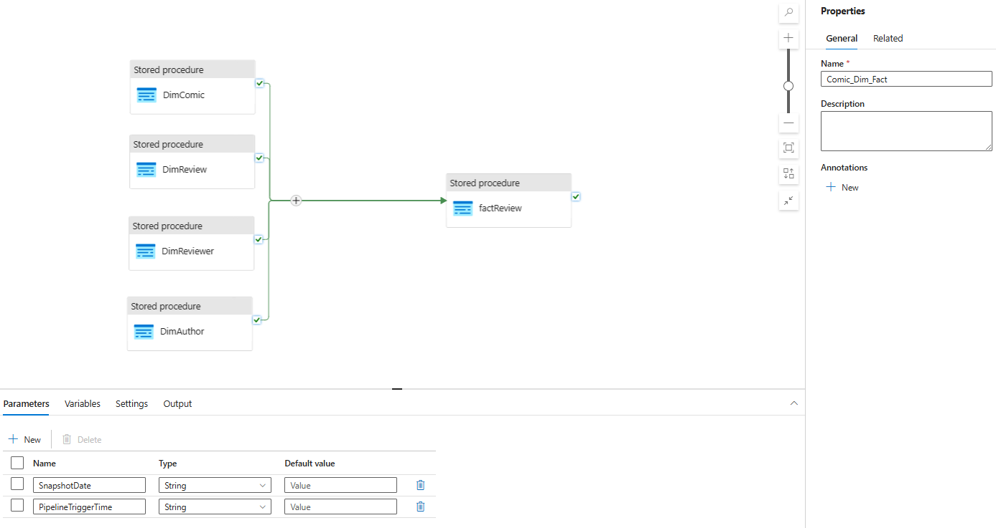
transformation -- Automation process
If we want the data to be updated frequently, we can directly add all of the procedure after the data is loaded. In this case, the refresh frequency will be the same as the data loading
If the data updated is not needed really frequent, we can create another pipeline to run the procedure with a longer interval on Monday, Wednesday and Friday

Slide 14
Part 3 Data Quality & Analysis

Slide 15
Data Quality & Analysis -- Data quality rule definition
From the FactReview table, the column for ‘IsReward’ is 0 while ‘RewardAmount’ is not null
From the FactReview table, the column for ‘IsReward’ is 1 while ‘RewardAmount’ is null
CostPerComic is less than 5 EUR
Review day is earlier than the comic created date
Reviewer’s birthday is later than the accountcreateddate
Reviewer rate is less than 1 or larger than 10
Same reviewer rated the same comic with same rate more than 1 times
Some other not null/null values in tables

Slide 16
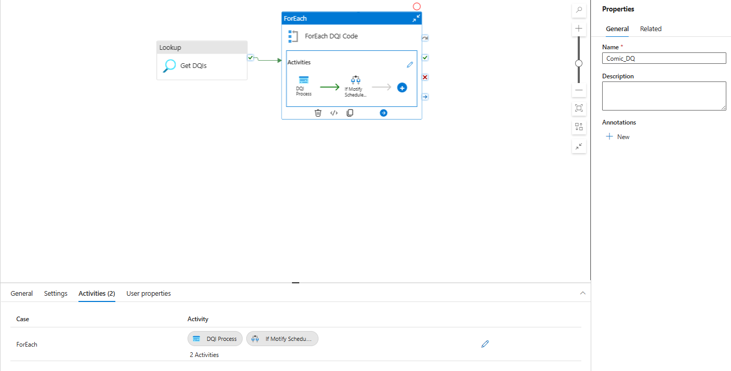
Data Quality & Analysis -- Data quality process
Create a view to include data quality definition, including DQID, DQDes,QueryBadData, QueryAllData, Message, etc
Create a procedure to run for one DQ item, to query bad data, calculate the ratio and generate the message for each bad records
Together with the process for dim and fact tables, run the procedure to get information for DQ. And followed with a notification to data owners.
Can also create a data quality report for internal usage.
Please find the view definition with two example dq rules here
Please fine the procedure here
DQ Process

Slide 17
Data Quality & Analysis -- Data analysis
*Assumption: Senior leadership will be interested in
What is the current status of revenue, customer traffic and conversion rate for reward (Current)
How to allocate resource to get higher revenue, for both authors and customers (Future)
Overall, we can create visualized report to show leadership the data which can help them make decision.
There is also some idea about how to analyze data.
How should they do the advertisement to attract more customers/reviewers?
From the review table, combine with customers/reviewers' data we can get the information for people from which nation/gender/age prefer to spend money there. Do the advertisement to the reviewers who have the similar profile
Combine the information about the author profile, customer profile and the comic content, analyze the relationship between customer profile with author profile and content. Do the recommendation based on the results.
2. Which author/comic has the largest potential that they can investment more to get higher income.
Based on current data we have, to analyze which authors/comics have the top attention per month per comic (number of views * Duration / number of months since creation)
Based on the cost and reward get from reviewers/customers, to see which authors/comics have the highest margin per month ((sum(rewardamount) - Cost) / number of month creation)
Use rate data and comment data to do text analysis, to measure the quality of the comic
Trend. Use time analysis to show the quality/attention and margin they got by time

Slide 18
Part 4 Challenge & Further idea

Slide 19
Challenges & Further Ideas
Challenges
Further Ideas
Lack of documentation for the meta data explanation for comic data.
Lack of other example data to build the data model and do further analysis.
Don’t have enough fields in main table provided. (feel dry to do data model and transformation.)
Enrich Entity Control table. In real practice, we will must have a bunch of data in different topic to do the proper analysis. Thus different entity is needed
Automate the process creating the control table by using endpoint to get JSON schema
Can also save all of the imp dataframe into datalake. In this case we can get all of the history file saved. At the same time can use event trigger, as long as there is a new file in data lake, data will be copied into database.
Use table type parameter (user defined table type) when insert the data into table. To improve the performance and can directly have table as current table. But if there is something wrong with the insert, need to debug from Azure Function code.
Not sure whether this API have webhook setup to inform user when there is some change in API. If so, can use event trigger.
For dq, can also calculate the dq rate and fix rate.

Slide 20
THANK YOU for your patience
ANY OTHER QUESRIONS?

